Slide 1
ITSM – Session 11
Dr. Phalachandra HL
Acknowledgements:
Significant portions of the information in the slide sets presented through the course in the class are extracted from IT Systems Management -Rich Schiesser and other books/Internet. Since these were intended for presentation in the class room for teaching, instructor resources has been requested from the publisher, but not received yet. I would like to sincerely thank, acknowledge and reiterate that the credit/rights remain with the original authors/publishers only

Slide 2
IT Systems Management
Recap
IT Infrastructure Systems Management involves managing the IT Services running on the IT infrastructure environment components like the Servers, Disk Storage, DBs, Networks and Desktop environments, and providing a stable and responsive IT environment, which supports or furthers the Business of the organization, while being Available, Responsive, Cost efficient, Secure, Scalable,…
We discussed on the support needed from executives, organization structure and positioning of the groups which provide these management services, given that one of the KSF are people, we discussed on approaches for staffing and retaining people with required skills and skill levels, the personal and business ethics or lack of it and it’s impact in-terms of legislation and what that drives into organizations
We also looked at how to evolve the services to a customer centric approach and leveraging the best practices using frameworks like ITIL
Then as part of the 12 Key processes which have been discussing in the course from Availability, Performance-Tuning, Production Acceptance process, Change Management, Problem Management, Storage Management, Network Management, Configuration Management, Capacity Management, Strategic Security, Business continuity and Facilities Management

Slide 3
World-Class Infrastructure
What in your opinion characterizes a World Class IT Infrastructure

Slide 4
World-Class Infrastructure
World Class IT infrastructure can be characterized by its
Alignment to Business Needs and Direction
Executive IT head is part of and has influence in the decision making team
There is support and understanding that IT has an influence on the Business
Ability to provide highly reliable, available secure infrastructure
Having a high (internal) customer satisfaction where their needs are being met and they’re comfortable trusting their critical business processes to the IT infrastructure and see IT organization as an important partner in meeting their mission.
Having well established metrics which are collected and used
Cost effectiveness - offering service at competitive cost/rates and has well documented costs of service
Support for data integrity – Secure, current and consistent, backed-up etc.
People related process which is enabling, supporting and rewarding
Adoption of technology and practices for tracking and future-proofing of the infrastructure
Having Robust processes which are integrated

Slide 5
World-Class Infrastructure
Factors that qualifies an environment to be World Class (as from the book)
1. Executive Support
2. The right meaningful metrics collected and analysed
3. Identify and prevent potential issues for performance and availability proactively
4. Identify, root cause, solicit feedback, analyse trends as part of Call Management
5. Employee Empowerment through communication, training and support
6. Develop, Leverage and use standards as applicable
7. Well-trained and equipped employees for the job
8. Build and maintain robust Processes
9. Use technologies like automation effectively
10. Integrate Systems Management Functions as much as possible

Slide 6
Factors contributing to World-Class Infrastructure 1
These are some of the factors that contribute to a world class infrastructure.
Executive Support
Acquiring executive support from budgetary support, active participation in the planning, development, and decision-making processes of systems management is one of the primary prerequisites for implementing a world-class infrastructure
This includes helping to prioritize which functions, backing up their staffs when negotiating reasonable and reasonable service levels with customers, actively support and comply with established infrastructure policies, procedures, and standards
2. Meaningful Metrics Analysed
Establishment of truly meaningful metrics and deriving conclusions from the data happens in World Class Infrastructures
E.g. Uptime -> Reactive – Proactive – What time - Impact from a customer availability perspective
E.g. Interference issue in the Aerospace firm due to maintenance activity by the carrier of the encrypted network line

Slide 7
Factors contributing to World-Class Infrastructure 2
3. Proactive Approach
World-class infrastructures employ a proactive approach to identify and prevent potential problems impacting performance and availability e.g. use and analysis of meaningful utilization metrics to predict when an out-of-capacity condition can occur, proactively identifying and preventing bottlenecks and outages
4. Call Management
Call management in World Class Infrastructures includes logging problems, tracking of problems, age, and escalated calls, pinpointing of root causes, soliciting of customer feedback, analysis of trends, patterns, and relationships between problems, changes, and other factors.
5. Employee Empowerment
World Class organizations have empowered employees, who are given authority and management support for decision making.
This empowerment is supported by having good communication, training, empathy, and support for employees for learning from fault decision making.

Slide 8
Factors contributing to World-Class Infrastructure 3
6. Well-Developed Standards
Standards can simplify maintenance, shorten deployment times, and ultimately reduce costs, when thoroughly developed and effectively enforced
Identifying and developing the standards happens in World Class organizations when all the relevant stakeholders including internal and external customers and suppliers, participate in its design, implementation, and enforcement
7. Well-Trained Employees
World-class infrastructures invest heavily in training their staff. This training could be on-the-job training, onsite classroom instruction, offsite courses, mentoring, cross-training etc.
8. Well-Equipped Employees
World-class infrastructures not only have well-trained but also have well-equipped employees
Top-rated infrastructures usually find the means to provide the tools (laptops, software ..) their technicians need which in turn reduces the problem resolution times, reduces the length of outages and reduces duplicate work efforts

Slide 9
Factors contributing to World-Class Infrastructure 4
9. Robust Processes
World-class infrastructures know how to develop, design, and maintain robust processes.
Discussed in detail in a few minutes
10. Effective Use of Technology
In organizations with world class infrastructures, the process are first robustly built and then the streamlining happens with automation.
11. Integrated Systems Management Functions
World Class Infrastructure Integrate and build relationships between problem management and other management areas such as change, availability, networks, and performance and tuning.

Slide 10
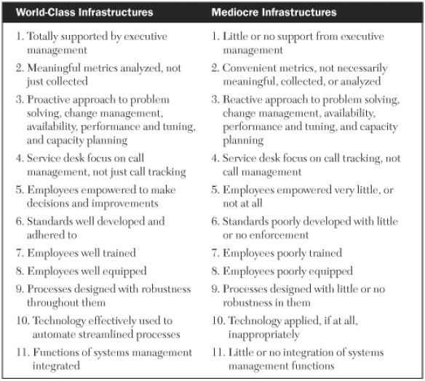
Contrasting a World-Class & Mediocre Infrastructure

Slide 11
Developing Robust Processes

Slide 12
Characteristics of a Robust Process
Since one of the distinctions that separate world-class infrastructures from those that are just marginal is the robustness of their processes, here are some characteristics of a robust process
1. Process Objective Is Identified
2. Executive Sponsor Is Identified & Involved
3. Process Owner Is Identified & Given Responsibility for & Authority Over the Process
4. Key Customers Are Identified and Involved
5. Secondary Customers Are Identified and Consulted
6. Process Suppliers Are Identified and Involved
7. Process Outputs Are Identified
8. Process Inputs Are Identified
9. Process Is Described by a Sound Business Model
10. Process Hierarchy Is Understood
11. Execution Is Enforceable
12. Process Is Designed to Provide Service Metrics
13. Service Metrics Are Compiled and Analysed, Not Just Collected
14. Process Is Designed to Provide Process Metrics
15. Process Metrics Are Compiled and Analysed, Not Just Collected
16. Documentation Is Thorough, Accurate, and Easily Understood
17. Process Contains All Required Value-Added Steps
18. Process Eliminates All Non-Value-Added Steps
19. Process Guarantees Accountability
20. Process Provides Incentives for Compliance and Penalties for Avoidance or Circumvention
21. Process Is Standardized Across all Appropriate Departments and Remote Sites
22. Process Is Streamlined as Much as Possible and Practical
23. Process Is Automated Wherever Practical, but Only after Streamlining
24. Process Integrates with all Other Appropriate Processes

Slide 13
Characteristics of a Robust Process - 1
Definition of Robustness of a process
The ability of a process to demonstrate acceptable quality and performance while tolerating variability or errors in inputs is referred to as robustness. The process should handle unexpected actions or terminations gracefully and display meaningful messages
There are 24 most common attributes which defines a Robust Process
No | Attributes | Comments
1 | Process objective is identified | Overall objective of the process needs to be stated, written down, shared with all appropriate parties, and agreed to and clearly understood by all process design participants. It should answer the questions of What problem the process will solve Which issues will it address How the process will add value and quality to the environment.
2 | Executive Sponsor Is Identified and Involved | Passionate about successful & ongoing execution of the process Provides support, resources, insight, and executive leadership, communication

Slide 14
Characteristics of a Robust Process - 2
No | Attributes | Comments
3 | Process Owner Is Identified and Given Responsibility for and Authority Over the Process | Leads the team that designs the process, identifies the key customers and suppliers of it, and documents its use Executes, communicates, and measures the effectiveness of the process on an ongoing basis
4 | Key Customers Are Identified and Involved | Involvement of Key customers (those who are the immediate users and direct beneficiaries of the process) in developing the process is important to ensure practical design and ease of use
5 | Secondary Customers Are Identified and Consulted | Consultation with secondary customers (those that may use a process less frequently or who may be the eventual beneficiaries of the process) can be helpful
6 | Process Suppliers Are Identified and Involved | People providing inputs to the process Could be internal to IT infrastructure External to IT infrastructure but internal to IT Internal to the company but outside of IT or External to company like the vendors are identified & engaged
7 | Process Outputs Are Identified | These are the specific deliverables or services being provided to the primary and secondary customers. The quality of the delivery and content of these outputs is usually measured with service metrics.

Slide 15
Characteristics of a Robust Process - 3
No | Attributes | Comments
8 | Process Inputs are Identified | Inputs required for the process are identified. These could be Soft inputs like data, information, or requests Hard inputs such as tapes, memory sticks or other physical entities.
9 | Process Is described by a Sound Business Model | Robust Processes should make Business sense Benefits of using the process should exceed the cost and efforts expended to design, execute, and maintain the process This may involve lease and maintenance agreements and SLAs
10 | Process Hierarchy Is Understood | Processes can have secondary processes, or sub-processes below them. There is a need for understanding the relationships between the primary and secondary processes
11 | Execution Is Enforceable | All processes need to be enforced to be effective whenever possible Software techniques such as passwords, authorizations, audit trails, or locks should be used to enforce compliance with a process Whenever technical enforcement is not practical, procedural techniques should be used to ensure enforcement like management enforced, review boards or metrics

Slide 16
Characteristics of a Robust Process - 4
No | Attributes | Comments
12 | Process Is Designed to Provide Service Metrics | Involves quantitative measure associated with the output There is a focuses on qualitative measures that are oriented toward the end-user and show the relative quality of the service being provided
13 | Service Metrics are Collected, Compiled and Analyzed | Robust processes associate real value to the measurements by thoroughly and consistently examining these metrics for trends, patterns, and relationships and then applying the results of the analysis to improve the effectiveness of the particular service being measured.
14 | Process Is designed for providing Process Metrics | Robust processes have service metrics and also process metrics focusing on how efficient a process is in regards to a supplier
15 | Process Metrics are Collected, Compiled and Analyzed | These would need to compiled and analyzed for missed process metrics and consistently examined for trends, patterns, and relationships and then the results of the analysis applied to improve the efficiency of the particular service being measured.
16 | Documentation are thorough, accurate, and easily Understood | Robust processes have well-written documentation facilitating the training, maintenance, and marketing of key processes. These processes documentation created with accountability, are reviewed and pruned to contain only those steps which add value

Slide 17
Characteristics of a Robust Process - 5
No | Attributes | Comments
17 | Process Contains all Required Value-Added Steps | The process should contain all the value-added steps which effectively increases the value of the Process to the end result These steps are identified by Key customers, suppliers, and process owners enabling them to be appropriately inserted into the final process
18 | Process Eliminates All Non-Value-Added Steps | Steps in the process needs to be critically evaluated and those steps which are not directly contributing value to the overall objective of the process, should be eliminated so that eventually the process can be automated
19 | Process Guarantees Accountability | Process metrics, Performance charts and Trending reports should be capable of quickly identifying accountability of the department and individual, to take necessary actions & help enforcement of the processes.
20 | Process Provides Incentives for Compliance and Penalties for Avoidance or Circumvention | The most effective incentives for compliance would be when it takes more effort to bypass the process than follow it. Eco-system should remove the obstacles normally associated with using a process and insert roadblocks for circumvention Security measures such as passwords and locks, as well as management measures such as exception reports and accountability, can discourage circumvention

Slide 18
Characteristics of a Robust Process - 6
No | Attributes | Comments
21 | Process is Standardized across all appropriate Departments and Sites | Process can become different in different locations due to acquisitions/mergers etc. which are then optimized to an agreed standard across sites
22 | Process Is Streamlined as Much as Possible and Practical | Streamlining a process involves removing all non-value-added steps, eliminating redundant steps, placing the steps in the most efficient sequence possible, and streamlining individual steps as much as possible
23 | Process Is Automated Wherever Practical, but Only after Streamlining | Automation can end up being either beneficial or detrimental depending on how the automation is designed and implemented
24 | Process Integrates with all Other appropriate Processes | Several processes within systems management naturally complement each other. For example Problem and Change management are separate processes, but they often rely on each other for optimum effectiveness. Performance/Tuning and capacity planning are almost always closely related to each other. The degree to which processes complement and integrate with each other is a valuable characteristic

Slide 19
Developing Robust Processes
Differentiating a Formal and an Informal Process
Formal Process is a procedure or methodology in which all of the major steps are explained and documented
An Informal process could be a more detailed account of its corresponding formal process, and may include few more small but critical informal steps which are most times undocumented
A robust process would need to include all of the formal and the informal critical steps which makes the process to be effective. Streamlining and eventually automation are most effective when both are factored in.

Slide 20
Developing Robust Processes
Helpful Ground Rules for Brainstorming
The development of a robust process requires several activities that consider the inputs of stakeholders, cross functional teams and key customers.
Brainstorming sessions help in soliciting and concluding on those requirements, priority, optimal designs consensus of opinion, and all-important buy-in from diverse groups.
These Brainstorming sessions are most effective and efficient with some of these rules
Agree on the clear objective(s) of the brainstorming.
Stay focused on the objectives(s).
Treat everyone as equals.
Listen respectfully to each person’s input.
Participate honestly and candidly.
Maintain confidentiality when appropriate.
Keep an open mind; suspend personal agendas.
Ask anything—there are no dumb questions.
Question anything you don’t understand.
Speak only one voice at a time; no side conversations.
Ensure everything relevant gets written down.
If prioritizing, agree upon specific technique.
If attempting consensus, agree upon voting method.
Start and end on time: session, breaks, lunch.
Critique the brainstorming session for improvements.
Treat these as guidelines, not rules; customize as needed.

Slide 21
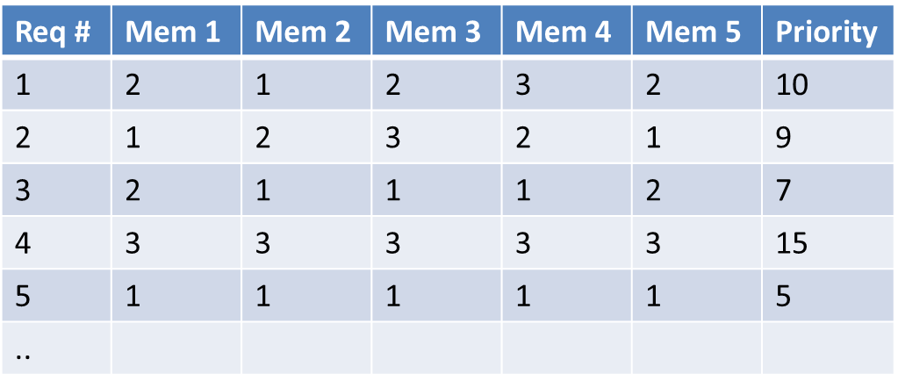
Developing Robust Processes
Methods for Prioritizing Requirements
Once the requirements for a particular discipline are identified, they will need to be prioritized in a consensus fashion in a cross functional team
Getting consensus in a cross functional team of 1-15 participants on the rankings of as many as ~50 requirement items can be a laborious, frustrating, time-consuming challenge
Approaches used to prioritize the requirements involves displaying all of them, scrutinizing them for merger or for removing of identical/similar requirements, and renumbering the pruned list
Approach 1 : Each member assigns a medium, high and low designation to each requirement, which can then be equated to a value and then ranked based on the total values in an ordinal fashion
If there are 5 members then the priority can only be values between 5 and 15. In case of number of requirements are more than 5, then priority value will get repeated
You could add a value in between and make it Low-1, Low-Med 2, Med 3, Med-High 4 and High 5 which adds more states
Approach 2 : You could rank the requirements in an ordinal fashion from 1 to max by each and sum up for each of them. Lowest to Highest (NGT Nominal Group Technique)

Slide 22
Effectively use Technology to Automate and Evaluate Robust Processes

Slide 23
Using Technology to Automate and Evaluate Robust Processes
Degree to which processes are automated differentiates a Robust Process form a Non Robust one which in turn can make a process to be World Class or not.
We will look at the
Preparatory steps necessary for automating a process successfully and discuss how to use technology properly in this activity.
Then will look at evaluating the robustness of the process based on around 24 characteristics of the process.

Slide 24
Automating Robust Processes
Automation can greatly streamline processes, reduce cycle times, increase efficiency, minimize errors, and generally improve the overall service levels of an infrastructure when done on a well designed process
Automation on a poorly designed process can lead to outputs which we may come-in quickly, but most likely will be unacceptable in quality and content.
Applying the wrong type of technology to automate a process can also cause more problems than not automating at all
Processes should not be automated until three key conditions have been met
The process should be well‐designed and standardized to the maximum extent achievable so that it can be replicated
The process must be streamlined as much as possible by removing non value added steps
Discretion should be exercised. Select only those parts of a process for which automation solidly applies and then apply the proper type of technology.

Slide 25
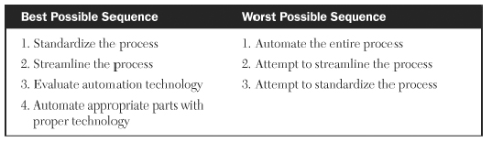
Automating Robust Processes
Managers should fully understand the type and scope of automation being planned. Automation types usually come in the form of hardware, software, or some combination of the two
The only correct sequence of activities is as follows:
1. Standardize a well‐designed process.
2. Streamline that process.
3. Evaluate thoroughly the relative fit of the automation technology to the process
4. Automate the appropriate pieces with proper technology,

Slide 26
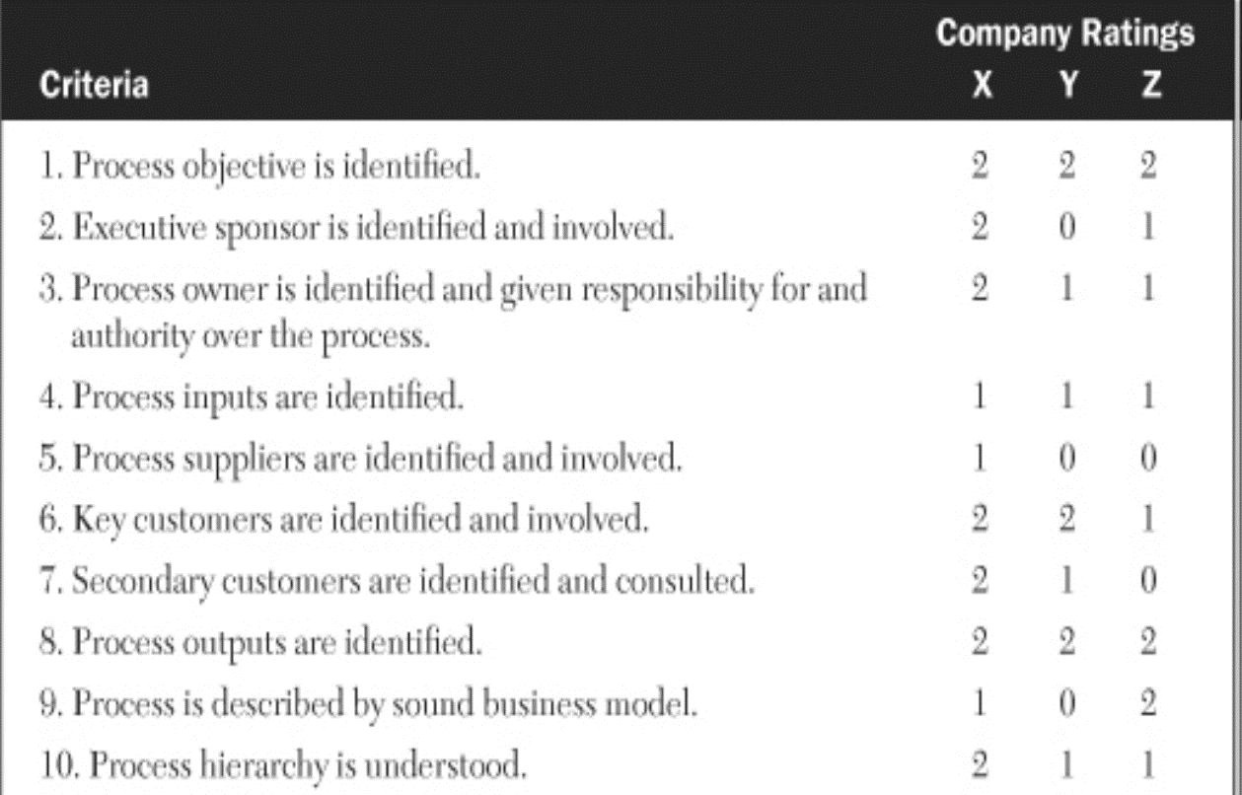
Evaluating an Infrastructure Process for its robustness
Once we have the attributes which characterize a robust process, evaluation of the process can be done using a non weighted or a variant with a weighted value for attributes
Each of the 24 attributes is rated as to the level of its importance to values of 0 if absent, 2 if present and 1 in case its available to some degree. If we consider 3 companies, the ratings can be as below

Slide 27
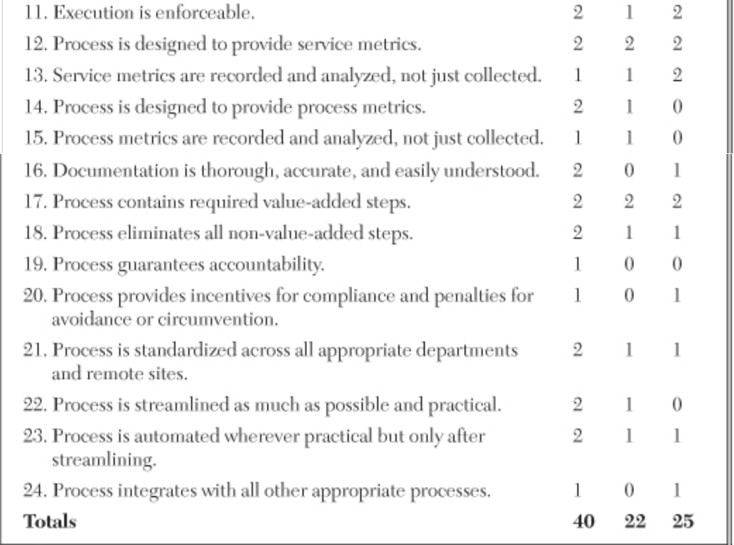
Using Technology to Automate and Evaluate Robust Processes
Evaluating an Infrastructure Process for robustness (contd.)

Slide 28
Integrating Systems Management Processes

Slide 29
Integrating Systems Management Processes
We will look at the various relationships between the 12 processes discussed to learn which ones integrate with which in the best manner
We will look at the degree to which each of these processes are tactical or strategic which can help in understanding the integrating relationships between these processes
One of the key factors which influences the integration is whether a process is more strategically focused or tactically focused. So we will
Distinguish a Strategic Processes and Tactical Processes
Identify the strategic and tactical processes studied
The Value of Distinguishing Strategic from Tactical Processes
Relationships Between Strategic and Tactical Processes
Difficulties with Integrating Solely Tactical Processes
Difficulties with Integrating Solely Strategic Processes
Difficulties with Integrating Tactical and Strategic Processes
Examining the Integrated Relationships Between Strategic and Tactical Processes
Significance of Systems Management Process Relationships

Slide 30
Integrating Systems Management Processes
Distinguishing Strategic and Tactical Processes and advantages from this
Sl. No | Strategic | Tactical
1 | Long range In nature | Short range in nature
2 | Two to Three years horizon | Day to Day focus
3 | Supports long term Business goals | Supports short term SLAs
4 | May require months to see results | Should see results in few days or weeks
5 | May need additional budget approvals for implement | Should already be in the existing budget
Two Tactical processes interact differently to two strategic processes and so would a tactical and strategic process. Categorizing processes as either tactical or strategic assists in addressing integration issues and supports optimal effectiveness
Process owners may also have strengths in tactical or strategic and will help in choice of the owners
The nature of the process will provide an indication on orientation of the infrastructure. An infrastructure that focuses mostly on tactical processes tends to be more reactive in nature, while those focusing on strategic processes tend to be more proactive in nature.
This also helps in determining if any improvements are needed whether these would need to be tactical or strategic in nature

Slide 31
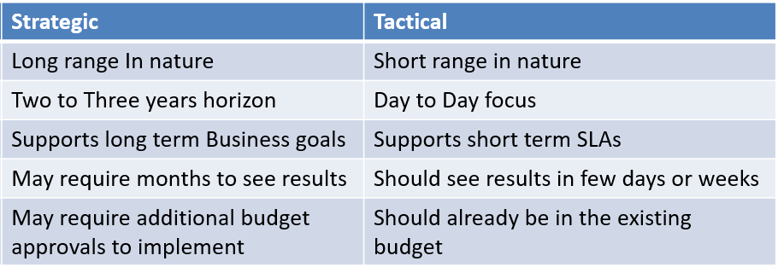
Integrating Systems Management Processes
Identifying Strategic and Tactical Processes in the processes studied
Considering the definitions of the 12 processes and the characteristics of the processes,
the processes are designated as Strategic and Tactical as follows
Strategic processes
Production acceptance
Capacity planning
Strategic security
Business continuity
Facilities management
Tactical Processes
Availability
Performance and tuning
Change management
Problem management
Storage management
Network management
Configuration management
Although each of the strategic one’s have a tactical aspect associated, more value of each one of them is in the strategic attributes.
Similarly each of the tactical one’s have a strategic aspect associated although more value of each of them is in the tactical attributes

Slide 32
Integrating Systems Management Processes
Identifying Strategic & Tactical Processes (Contd.)
E.g. of Strategic Processes having Tactical orientation:
Tactical part of Production Acceptance, Capacity Planning, and Disaster Recovery involves the important activities of deploying production software, provisioning for hardware upgrades, and restoring business operations, respectively. But analysts responsible for these critical events cannot execute these successfully without a strategic focus involving thorough planning and preparation
Strategic Security and Facilities Management tactically monitor the logical and physical environments for unauthorized access or disturbance on a continual basis. But the overriding objective of ensuring the ongoing integrity and use of the logical and physical environments requires significant strategic thinking to plan, enforce, and execute the necessary policies and procedures.
E.g. of Tactical Processes having Strategic orientation:
The Network and Storage Management processes involve not only the installation of network and storage equipment but the planning, ordering, and scheduling of such hardware as well—activities that require months of advance preparation. But the majority of activities associated with these two processes are tactical in nature, involving real-time monitoring of network and storage resources to ensure they are available and in sufficient quantity

Slide 33
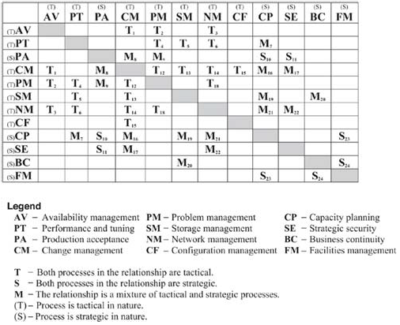
Integrating Systems Management Processes
Relationships Between Strategic and Tactical Processes
Each of the 12 systems management processes integrate with, & depend on, other processes for optimal use.
Some processes have no significant interaction, or relationship, with another specific process
Combination of two tactical processes results in a significant process relationship, then the interaction of the two is designated T for tactical
Combination of two strategic processes results in a significant process relationship, then the interaction of the two is designated S for Strategic
If a significant relationship is the result of the combination of a tactical and a strategic discipline, then the interaction is designated as M for mixture
If the combination of any two processes, either tactical or strategic, results in no significant interaction, then the intersecting box is blank
Box in blue indicate processes with least interactions & red most interactions
20 Feb 2021
33

Slide 34
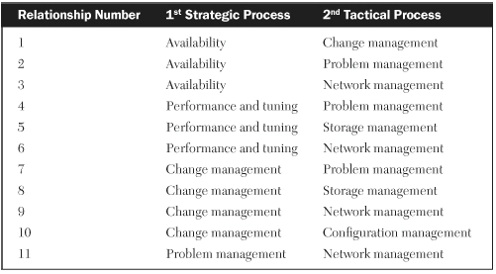
Integrating Systems Management Processes
Difficulties with Integrating Solely Tactical Processes
There are 11 relationships involving solely tactical processes. The difficulties of integrating solely tactical processes are
There is a tendency to emphasize only on short-term goals and objectives having very limited planning horizons, sometimes forcing an hour-to-hour focus of activities. If left unchecked, this tendency could undermine efforts at long-range, strategic planning.
Most of these now involve 24/7 coverage. The emphasis on around-the-clock operation can often infuse an organization with a reactive, firefighting type of mentality rather than a more proactive mentality
People who work in organizations with reactive continuous operative environments burnout quickly, and the organizations run the risk of losing their most precious resource the human talent.

Slide 35
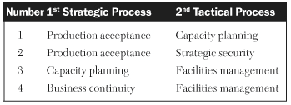
Integrating Systems Management Processes
Difficulties with Integrating Solely Strategic Processes
There are four relationships based solely on strategic processes The difficulties of integrating solely strategic processes are
Continuing emphasis on long-range planning sometimes results in key initiatives not getting implemented as the planning does not get followed with effective execution
These relationships need to be managed by individuals with a competent, strategic focus, but most of the infrastructure analysts/staff are more tactical than strategic in their outlooks, actions, and attitudes.
Budgets for strategic resources whether software, hardware or human, often get diverted to more urgent needs

Slide 36
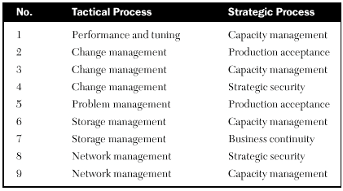
Integrating Systems Management Processes
Difficulties with Integrating Tactical and Strategic Processes
There are nine relationships formed by a combination of tactical and strategic processes. The difficulty is the mixing of tactical and strategic processes, the orientations of which may appear at odds with each other.
Short-range tactical actions do not mix well with long-range strategic plans. In case we do have common reliable, responsive systems and excellent customer service, the accomplishment of Business objectives can help to reconcile these apparent discrepancies.
This could also bring together process owners whose orientation between short- and long-range focus may conflict. Again, the emphasis on common goals can help to alleviate these divergent views..
The need to recognize which elements are truly tactical and which are truly strategic. For example, the combination of tactical change management and strategic capacity management is a mixed-process relationship. But some changes may require weeks of advanced planning, resulting in a strategic focus on what is normally a tactical discipline. Similarly, the last step of a major capacity upgrade is the installation of the hardware; this is a tactical activity associated with a normally strategic discipline. Knowing and understanding these differences can help to better facilitate the relationships of mixed processes

Slide 37
Integrating Systems Management Processes
Examining Integrated Relationships Between Strategic & Tactical Processes
There are 24 relationships possible while integrating processes which are detailed below
AV/CM(T). Availability and change management are tactical processes. The relationship here centers mostly on scheduled outages which should be handled as scheduled changes. Unscheduled outages should be treated as problems.
PT/CP(M). This mixes a tactical process (performance and tuning) with a strategic one (capacity planning). Poor performance and slow response times can certainly be attributed to lack of adequate capacity planning. If insufficient resources are available due to larger‐than‐expected workload growth or due to a greater number of total or concurrent users, then poor performance will no doubt result.
PA/SE(S). This is an all‐strategic relationship. New applications should have clearly defined security policies in place prior to deployment. An application security administrator should be identified and authorized to manage activities such as password expirations and resets, new‐user authorization, retiring userids, and training of the help‐desk staff.
…….
(please refer the book for the enumerated list of such relationships)

Slide 38
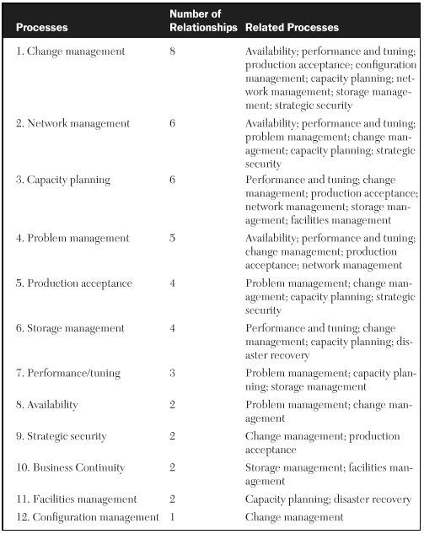
Integrating Systems Management Processes
Significance of Systems Management Process Relationships
Sorted list of the number of relationships associated with each discipline
This list indicates the order in which to look at the process for improving an IT infrastructure
Developing it into a more robust process will also likely improve several of the other processes with which it frequently interacts
The significance of these relationships is that they point out the relative degree of integration required to properly implement these processes.
Organizations that implement a highly integrated process like change management in a very segregated manner usually fail in their attempt to have a robust change process.

Slide 39
Special Considerations for
Client-Server & Web-Enabled Environments

Slide 40
Special Considerations for Deployment Environments : Client-Server and Web-Enabled Environments :
Introduction
One of the challenges faced by many infrastructure managers today is on how to apply the structure of these predominantly mainframe-developed processes to the less-structured environment of client/servers and unstructured environment of the Internet
As part of this we will look at some of the issues relating to processes implemented in a client/server environment that differ significantly from those implemented in a mainframe or midrange environment. We will also look at some of the cultural differences in a web-enabled environment as they relate to systems management processes
There are five key system management areas in relation to applying systems management processes to a client/server environment:
1. Vendor relationships
2. Multiplatform support
3. Performance and tuning challenges
4. Disaster‐recovery planning
5. Capacity planning

Slide 41
Special Considerations for Client-Server Issues:
Vendor Relationships
Since client/server environments can have environments with equipment from multiple vendors, Multiple vendor relationships need to be relied upon for marketing services, technical support, and field maintenance.
Multiplatform Support
Typically in a client/server environment, multiple platforms are frequently used (both hardware and software potentially from different vendors) due to their lower cost and diverse architectures, which allow them to be tailored and tuned to specific enterprise-wide applications. This would mean
Organizations will need to depend on vendor support as it gets difficult to afford and build expertise in-house to support these assets.
The total cost of supporting multiple technologies should be considered specially in the client-server environments prior to implementing systems management processes
Performance and Tuning Challenges
The number of performance and tuning parameters which crops up as part of client/server environment because of the variants of the servers and the OS^{s}, brings in its own challenges of requiring different skill sets and, in some cases, different software tools to effectively tune their host server systems. The various performance and tuning challenges include
Variations in operating system levels
Impact of database structures
Integration of disk storage arrays
Application System Changes
Complexities of network components
Different types of upgrades necessary on Desktops

Slide 42
Special Considerations for Client-Server Issues:
Variations in operating system levels
Different OS versions, and tuning components like memory size, number and length of buffers etc can complicate the tuning process.
Client Server environments typically have dedicated systems for applications and are challenged in tuning the OS^{s} due to frequent application updates, the expansion of usable data, upgrades of Hardware, Continual growth of users etc.
Impact of database structures
As the use and number of users of the client/server application increase, so does the size of its database. This growth can require ongoing changes to a number of tuning parameters, such as directories, extents, field sizes, keys, and indices.
As the number of total users increases, the transaction mix to the database changes, requiring tuning changes. As the number of concurrent users increases, adjustments must be made to reduce contention to the database.
Integration of disk storage arrays
The use of large-capacity storage arrays as resources in client/server environments leads to Huge databases and data warehouses to be housed economically in these arrays. Several databases are normally housed in a single array to make the storage devices as cost effective as possible. When the size or profile of a single database changes, tuning parameters of the entire array must be adjusted.
These include cache memory, cache buffers, channels to the physical and logical disk volumes, the configuration of logical volumes, and the configuration of the channels to the server.

Slide 43
Special Considerations for Client-Server Issues:
Performance and Tuning Challenges (Contd.)
Application system changes
Applications tend to be changed and upgraded more frequently in Client Server environments due growth of users, databases, and functional features. These changes usually require tuning adjustments to maintain performance levels.
Complexities of network components
Application and database changes also affect network tuning. Most firms use an enterprise-wide network to support multiple applications. Different applications bring different attributes of network traffic. Some messages are large and infrequent while others are short and almost continuous. Networks in these types of environments must be tuned constantly to account for these ongoing variations in network traffic.
Differing types of desktop upgrades necessary on the same Desktop
As more applications are made accessible to a given shared desktop, it will most likely need to be retuned and upgraded with additional processors, memory, or disk drives which can get more complex as the variety of applications change increases within the department

Slide 44
Special Considerations for Client-Server Issues: Disaster Recovery Planning
The other consideration in a client/server environment is that of disaster recovery and business continuity which involves five issues.
Variations in the types of Server platforms in a client/Server shop with different architectures where critical applications can reside on servers of differing architectures
This leads to disaster-recovery plans having 3 options
Selecting a single server architecture on which the majority of mission critical applications reside and around which one can develop the recovery process. Exposure due to the risk of exclusion of the other critical applications would exist
Select a standard server architecture and Run all critical applications on this single architecture, needing extensive qualification and potential performance issues
Design the recovery process with multiple server platforms. Ensure that these platforms can accommodate all critical applications. This approach will yield the most comprehensive disaster recovery plan, but it is also the most complex to develop, the most cumbersome to test, and the most expensive to implement. Nevertheless, for applications that are truly mission‐critical to a company, this is definitely the strategy to use.
Greater variation in types of server platforms
Larger number of servers to consider
Network connectivity more complex
Need to update more frequently
Need to test more frequently

Slide 45
Special Considerations for Client-Server Issues: Disaster Recovery Planning (Contd.)
Large number of Servers required to support mission-critical applications even if servers are all of similar architecture
Multiple servers imply that there will be more control software, application libraries, and databases involved with the backing up, restoring, and processing of segments of the recovery processes. These segments all need to be thoroughly tested at offsite facilities to ensure that business processing can be properly resumed.
Network connectivity becomes more complicated when restoring accessibility to multiple applications on multiple servers from a new host site. Extensive testing must be done to ensure connectivity, interoperability, security, and performance.
Connectivity must be established among desktops, databases, application systems, and server operating systems.
There must be interoperability between servers with different architectures.
The network that is being used during a disaster recovery must have the same level of security against unauthorized access as when normal processing is occurring.
Performance factors such as transaction response times are sometimes degraded during the disaster recovery of client/server applications due to reduced bandwidth, channel saturation, or other performance bottlenecks. Heightened awareness of these network issues and thorough planning can help maintain acceptable performance levels during disaster recoveries.

Slide 46
Special Considerations for Client-Server Issues: Disaster Recovery Planning (Contd.)
Disaster recovery plans and their documentation needs to be frequently updated to ensure accurate and successful execution of the plans
Frequent testing to ensure that none of the modifications to the previous version of the plan undermines its successful implementation

Slide 47
Special Considerations for Client-Server Issues : Capacity Planning
The use of applications in an Client Server environment tends to expand rapidly and sometimes brings in increased demand for the various resources that support these systems. These resources include server processors, memory, disk, channels, network bandwidth, storage arrays, and desktop capacities.
The increasing demand on these resources necessitates accurate workload forecasts for all of these resources to ensure that adequate capacity is provided. Frequent updates to these forecasts are important to assure that an overall capacity plan is executed that results in acceptable performance levels on a continuing basis.

Slide 48
Special Considerations for Web-Enabled Environments Issues:
Most all companies today are using the Internet for web-enabled applications, but the degree of use, experience, and reliance varies greatly. Topics to consider when implementing systems management processes in a web-enabled environment and some special issues to consider when applying systems management processes to those application environments that are web-enabled through the Internet. Given this context of use, experience and reliance and other factors, we can divide companies using web-enabled applications into one of three categories.
The first consists traditional mainframe-oriented companies which are just about to start using widespread web enabled applications.
Challenges in terms of personnel not web savy and companies with traditional lifecycles
Resistance to change and release cycles being longer
The second category involves moderate-sized but growing enterprises which started using web-enabled applications early on.
More amenable to change, exposed to web ..
The third category consists of dotcom companies which rely mostly on the Internet and web-enabled applications to conduct their business.
48

